Slide 1
THE SOUNDS OF THE ENGLISH LANGUAGE
VOWEL AND CONSONANT SOUNDS

Slide 2
LEARNING OBJECTIVES
In this lesson, students will:
be able to identify the phonemes of the English language
be able to analyze and categorize the phonemes of the English language, distinguishing between vowels and consonants based on their articulatory features.

Slide 3
DEFINITION
Sound is the sensation perceived by the ear caused by the vibration of air or some other medium.
Vowel sounds are the sounds produced with little or no restriction to the passage of air in the oral cavity. There are twenty vowel sounds in English language: twelve monophthongs and eight diphthongs.
Consonant sounds are the sounds that are produced with restriction to the passage of air in the oral cavity. There are twenty-four consonant sounds in English language.
Therefore, there are forty-four sounds in the English language.

Slide 4
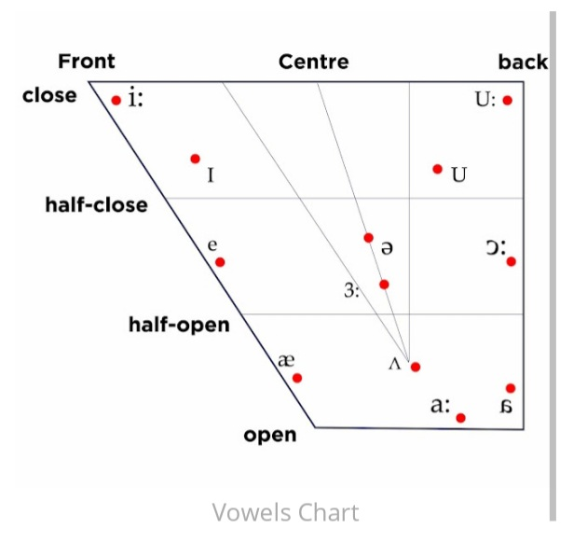
THE VOWEL CHART:
MONOPHTHONG

Slide 5
Monophthongs: Short vowel sounds
Short Vowels
IPA Symbol I | Word examples Ship, lip, tip, hip
E | Went, intend, send, letter
Æ | Cat, hand, nap, flat, have
ʌ | Fun, love, money, one, London, come
ʊ | Put, look, should, cook, book,
ɒ | Rob, top, watch, squat, sausage
ə | Alive, again, mother

Slide 6
Monophthong: Long vowel sounds
IPA Symbol | Word examples
i: | Need, beat, team
ɜ: | Nurse, heard, third, turn
ɔ: | Talk, law, bored, yawn, jaw
u: | Few, boot, lose, gloomy, fruit, chew
ɑ: | Fast, car, hard, bath

Slide 7
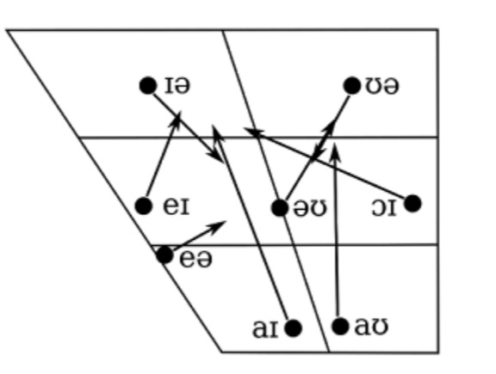
THE VOWEL CHART:
DIPHTHONG

Slide 8
Diphthongs
IPA Symbol | Word examples
ɪə | Near, ear, clear, tear, beer, fear
eə | Hair, there, care, stairs, pear
eɪ | Face, space, rain , case, eight
ɔɪ | Joy, employ, toy, coil, oyster.
aɪ | My, sight, pride, kind, flight
əʊ | No, don’t, stones, alone, hole
aʊ ʊə | Mouth, house, brown, cow, out Cure, pure, lure

Slide 9
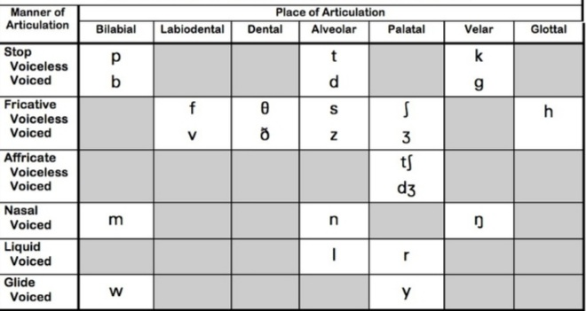
THE CONSONANT SOUNDS

Slide 10

Consonant Sounds: Plosives
IPA Symbol | Word examples
p | Pin, cap, purpose, pause
b | Bag, bubble, build, robe
t | Time, train, tow, late
d | Door, day, drive, down, feed
k | Cash, quick, cricket, sock
g | Girl, green, grass, flag

Slide 11
Consonant Sounds: Fricatives
IPA Symbol | Word examples
f | Full, Friday, fish, knife
v | Vest, village, view, cave
θ | Thought, think, Bath
ð | There those, brother,others
s z | See, sip, sleep, slap Zoo, crazy, lazy, zigzag, nose.
ʃ | shirt, rush, shop, cash
ʒ | Television, delusion, casual
h | High, help, hello

Slide 12
Consonant Sounds: Affricates
IPA Symbol | Word examples
ʈʃ | Choose, cheese, church, watch
/dʒ/ | Joy, juggle, juice, stage

Slide 13
Consonant Sounds: Nasals
IPA Symbol | Word examples
M | Room, mother, mad, more
N | Now, nobody, knew, turn
ŋ | King, thing, song, swimming

Slide 14
Consonant Sounds: Approximants
IPA Symbol | Word examples
r | Road, roses, river, ring, ride.
/j/ | Yellow, usual, tune, yesterday, yard.
W | Wall, walk, wine, worl
l | Law, lots, leap, long, pill, cold, chill, meltd

Slide 15
MANNER OF ARTICULATION
Plosive is produced after opening a previously closed oral cavity which produces an explosion-like sound (p, b, t, d, k, g)
Fricative is produced with a friction causing constriction in the oral cavity that produces a hissing sound(f, v, θ, ð, s, z, ʃ, ʒ, h)
Affricate is produced using a combination of a plosive and a fricative (ʈʃ, dʒ)
Nasal is produced through the nose by lowering the soft palate, and in some cases with closure of the oral passage (m, n, ŋ)
Liquid/lateral is produced with partial occlusion or closure in the oral cavity (l, r)
Glide/approximant is produced by narrowing the oral cavity slightly, but still allowing smooth flow of air (w, j)

Slide 16
PLACE OF ARTICULATION
Bilabial is produced using the two lips (p, b, m, w)
Labiodental is produced using the lower lip and upper teeth (f, v)
Dental is produced using the tip of the tongue and the teeth (θ, ð)
Alveolar is produced using the tip of the tongue to approach the alveolar (inner) ridge of the gums of the upper front teeth. (t, d, s, z, n, l)
Palatal is produced using the body of the tongue and the hard palate/outer roof of the mouth. (ʃ, ʒ, ʈʃ, dʒ, r, j)
Velar is produced using the body of the tongue and the soft palate/ inner roof of the mouth. (k, g, ŋ )
Glottal is produced at the glottis/larynx/vocal cord. (h)

Slide 17
CLASS ACTIVITIES
In groups, the students attempt the following questions
What are fricative sounds? Using two examples each, write them
out.
With two examples each, differentiate between voiced and
voiceless consonants.
Transcribe the following: judge, you, man, house, alive.

